Slide 1
Data Science: Healthcare- Persistency of a drug Final Project
Krishna Ratna Deepika Haripuram December 16^{th,} 2023

Slide 2

1. Problem Description
2. Business Understanding
3. Project Lifecycle
4. Data understanding (Type of data, problems and approaches to solve the problems)
5. Data Cleaning and Transformation (Techniques for handling missing Values & handling outliers and NLP featurization.)
6. EDA performed on the data
7. Preparing Data for Modeling
8. Model Training and Evaluation
Agenda

Slide 3
Data Science:: Healthcare - Persistency of a drug
Objective: Analyze healthcare dataset to understand drug persistency as prescribed by physicians.
Target Variable: 'Persistency_Flag' indicating medication adherence.
Key Goal: Identify factors influencing drug persistency.
Model Development: Build a predictive model to classify patients based on their adherence.
Significance: Enhance patient care, optimize treatment strategies.
Impact: Assist pharmaceutical companies in informed decision-making regarding patient treatment plans and healthcare policies.
Krishna Ratna Deepika Haripuram December 11^{th,} 2023
Problem Statement

Slide 4
In the pharmaceutical industry, understanding drug persistency is crucial, as it directly affects patient health outcomes and drives key business metrics.
Persistency rates are indicative of medication effectiveness, patient satisfaction, and overall treatment success.
High persistency rates are often correlated with better health outcomes, reduced hospitalization rates, and lower healthcare costs.
From a business perspective, insights into drug persistency are invaluable.
They enable pharmaceutical companies to fine-tune their marketing strategies, tailor patient support programs, and make informed decisions about drug development and formulation.
In essence, understanding persistency helps bridge the gap between patient needs and the treatments offered.
Business Understanding

Slide 5
Project Lifecycle
Week | Date | Plan
Week 7 | 19th Nov 2023 | Problem statement, business understanding and project lifecycle with deadline
Week 8 | 26th Nov 2023 | Problem description, Data understanding and identifying approaches to overcome problems like missing data, outliers etc.
Week 9 | 2nd Dec 2023 | Data cleaning and transformation
Week 10 | 9th Dec 2023 | EDA and model recommendation
Week 11 | 16th Dec 2023 | Presentation on EDA and proposed model technique
Week 12 | 23rd Dec 2023 | Model Selection and Model Building/Dashboard
Week 13 | 30th Dec 2023 | Final project report and code submission

Slide 6
Dataset Overview:
Provided File: 'Healthcare_dataset.xlsx'.
Comprises data of 3,424 patients.
Includes demographics, clinical records, risk factors, and physician specialty details.
Data Analysis Strategy:
Comprehensive Variable Analysis: Conducted on the entire dataset to understand each variable's impact.
Focus on Demographic and Clinical Variables: Examined to uncover patterns and correlations.
Exploratory Data Analysis (EDA):
Holistic Data Examination: EDA performed on the complete dataset for in-depth insights.
Goal: Identify significant trends and factors influencing drug persistency.
Model Development:
Developed a Predictive Model: Aimed at classifying patients based on 'Persistency_Flag'.
Utilized Advanced Analytics Techniques: To predict medication adherence and identify key influencing factors.
Approach

Slide 7
Type of Data for Analysis
Categorical Data: This includes variables like gender, race, ethnicity, and treatment types, providing a qualitative assessment of patient profiles and clinical scenarios.
Numerical Data: It encompasses quantitative variables such as the frequencyof DEXA scans and the count of risk factors, offering measurable insights into patient treatment and health risks.
Problems in the Data
Missing Values: The dataset showed no significant missing values, indicating completeness in data recording.
Outliers and Skewness: Notable outliers and skewness were observed in key numerical columns like `Dexa_Freq_During_Rx` and `Count_of_Risks`, which could potentially skew statistical analyses.
Approaches to Overcome Problems
Handling Skewness: Log transformations were applied to skewed numerical columns to normalize their distribution, enhancing their suitability for statistical models and machine learning algorithms.
Managing Outliers: Techniques like the Interquartile Range (IQR) method were employed for identifying and treating outliers, thus normalizing the data, and ensuring robustness in analysis.
Data
Understanding
The dataset for this project is a rich amalgamation of patient demographic details and clinical factors.
It includes various attributes like age, gender, race, and specific medical history details, along with treatment adherence indicators.
The data is comprehensive, covering aspects ranging from patient demographics to intricate clinical parameters and provider attributes.

Slide 8
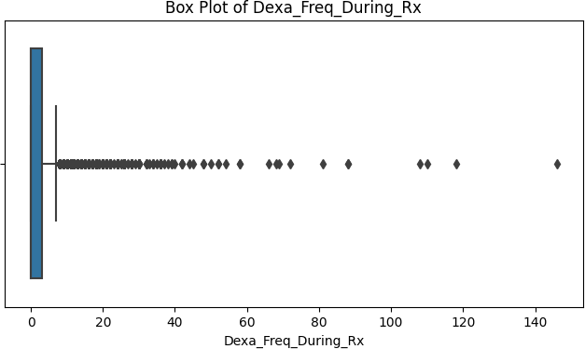
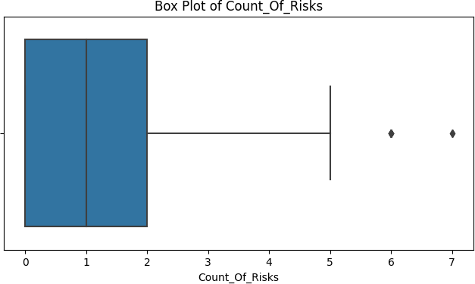
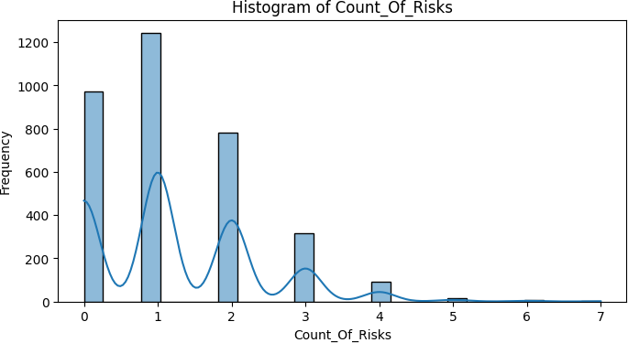
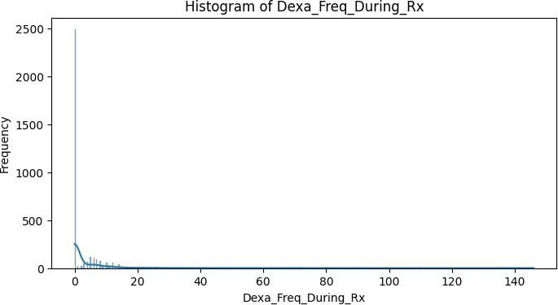
Data Visualization:
Histograms and box plots were utilized to visually assess the distribution of numerical columns, aiding in the identification and interpretation of skewness and outliers.

Slide 9
Handling Missing Values:
Applied various techniques like mean, median, and mode imputation to handle missing values in different columns.
Experimented with K-Nearest Neighbors (KNN) imputation as a model-based
approach for a comprehensive understanding of handling missing data in mixed-type datasets.
Outlier Detection:
Identified and handled outliers using methods like the Interquartile Range (IQR) for 'Dexa_Freq_During_Rx' and Z-score for 'Count_Of_Risks'.
These techniques helped in normalizing the data distribution and removing
anomalies that could potentially skew the analysis.
Weight of Evidence (WoE) Calculation:
Computed WoE for categorical variables to transform them into a continuous scale and gain insights into the predictive power of each category.
d. NLP Featurization and Data Cleaning:
Utilized regex for cleaning text data in columns such as 'Ntm_Speciality'and 'Risk_Segment_Prior_Ntm', removing non-alphabetic characters and standardizing the text.
Applied TF-IDF Vectorization on the 'Ntm_Speciality' column to convert the cleaned text data into a numerical format. This transformation is crucial for feeding textual data into
machine learning models.The sparse nature of the TF-IDF matrix (mostly zeros) is typical and reflects the uniqueness of terms in the documents.
Data Cleaning and Transformation

Slide 10
Review and Reflections:
In this project, I navigated challenges such as choosing suitable data cleaning methods and handling the sparsity in the TF-IDF matrix.
These experiences underscored the importance of understanding data at a deep level and maintaining data integrity through careful documentation.
This project reinforced the value of adaptability and critical analysis in data science, lessons that I will apply in my future endeavors.
Code Repository and Documentation:
All code and detailed documentation are maintained in the provided GitHub repository. Regular updates and comprehensive commenting in the code have been a priority to ensure clarity and reproducibility of the analysis.

Slide 11
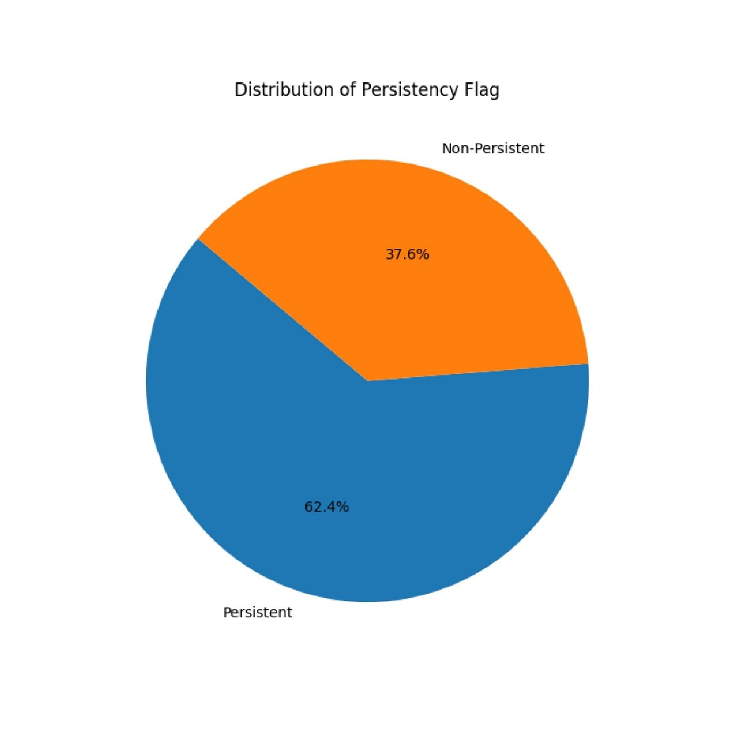
Distribution of Persistency Flag
The pie chart depicts the overall distribution of the persistency flag among patients.
A significant majority show persistence, but there remains a considerable portion that is non-persistent, highlighting the need for targeted interventions.

Slide 12
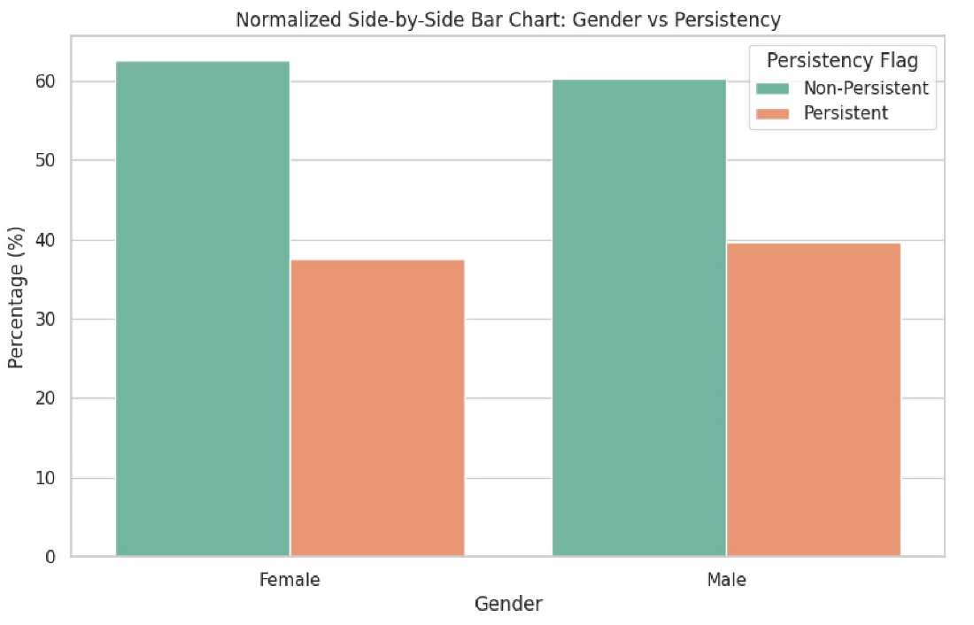
Gender vs Persistency
This normalized bar chart compares drug persistency rates between genders.
While there are slight differences, both genders show substantial non-persistent populations, indicating a need for gender-specific adherence strategies.

Slide 13
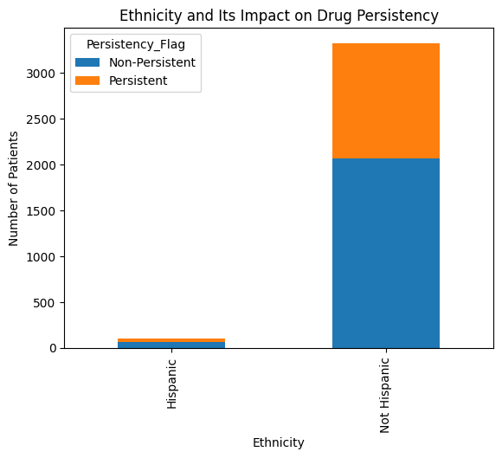
Ethnicity and Its Impact on Drug Persistency
The bar chart explores how ethnicity affects drug persistency, with notable differences between ethnic groups.
Understanding cultural and social factors could be key to improving patient-specific treatment plans.

Slide 14
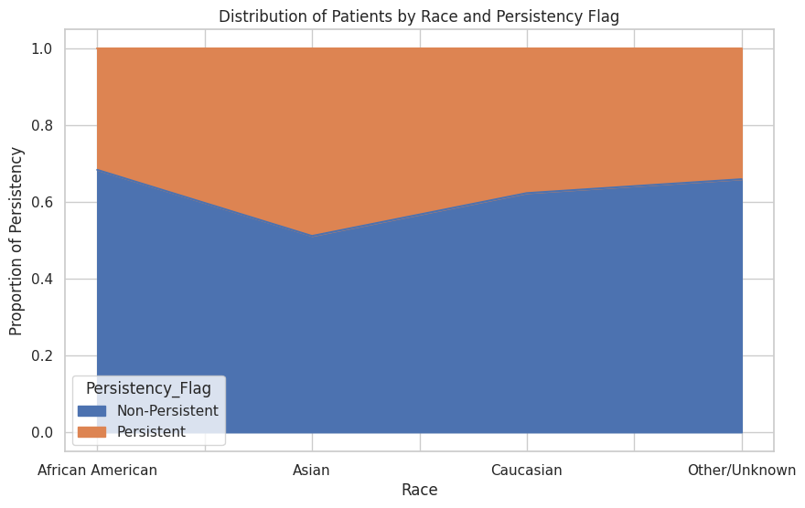
Distribution of Patients by Race and Persistency Flag
This stacked bar chart provides insight into drug persistency rates across different races.
The proportion of persistency within each racial group highlights potential disparities that could be addressed to improve medication adherence.

Slide 15
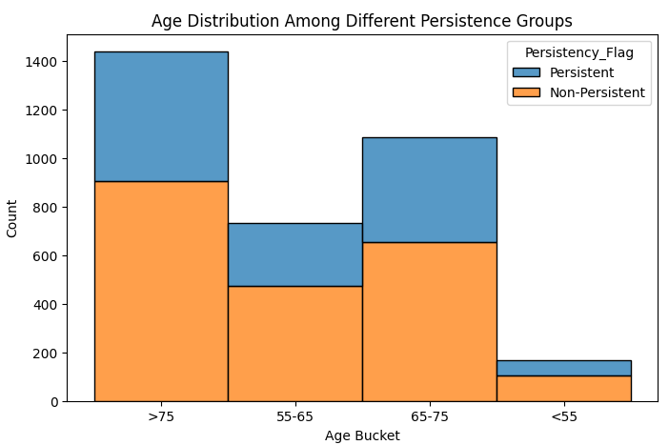
Age Distribution Among Different Persistence Groups
The bar chart compares the age distribution between persistent and non-persistent patients.
It reveals that persistence does not significantly differ across age groups, suggesting that other factors may play more critical roles in persistency.

Slide 16

Specialties of Healthcare Providers (Word Cloud)
The word cloud visually represents the various healthcare provider specialties, with the size of each term indicating its frequency.
General practice, surgery, and oncology are prominently featured, which could be influential in-patient drug persistency.

Slide 17
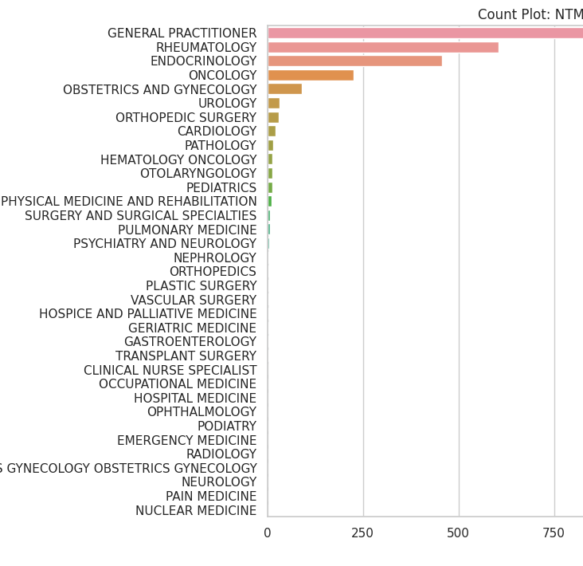
NTM Physician Specialty Distribution
The bar chart showcases the distribution of NTM physician specialties.
General practitioners are the most common, followed by rheumatologists and endocrinologists, indicating these specialties' roles in ongoing patient care and potentially influencing drug persistency.

Slide 18
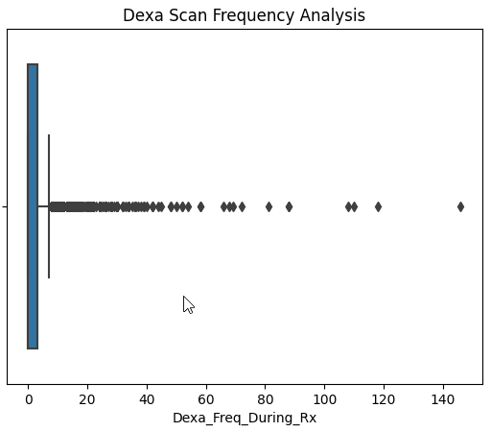
Dexa Scan Frequency Analysis
Boxplot displays the overall distribution of Dexa scan frequencies among all patients, showing a wide range but with most patients undergoing few scans, which may impact their treatment persistency.
It helps identify common ranges and outliers in scan frequencies, which can be critical in assessing patient engagement with their treatment plans.

Slide 19
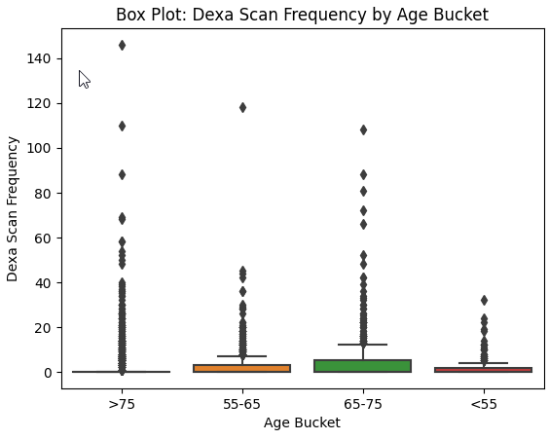
Dexa Scan Frequency by Age Bucket
The boxplot categorizes patients by age and the frequency of Dexa scans they received.
The data indicates that older patients (>75) are more likely to have frequent Dexa scans, which could be attributed to increased monitoring with advancing age.

Slide 20
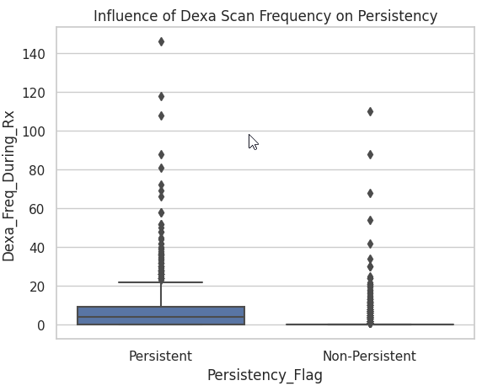
Influence of Dexa Scan Frequency on Persistency
This boxplot illustrates the distribution of Dexa scan frequencies among patients, categorized by their drug persistency status.
Notably, persistent patients tend to undergo Dexa scans more frequently, which may suggest a correlation between regular monitoring and medication adherence.

Slide 21
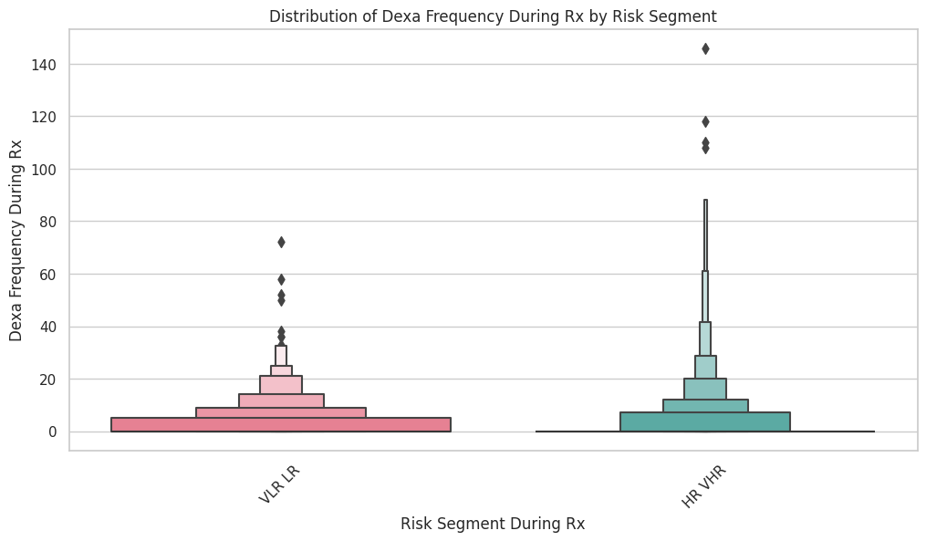
Distribution of Dexa Frequency During Rx by Risk Segment
This boxen plot compares the frequency of Dexa scans during treatment across different risk segments, suggesting that patients with a higher risk profile receive more frequent monitoring.

Slide 22
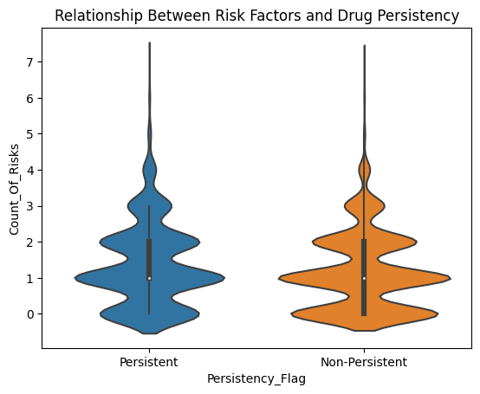
Relationship Between Risk Factors and Drug Persistency
The violin plot examines the relationship between the number of risk factors and drug persistency.
A higher number of risk factors is associated with increased persistency, possibly due to more intensive health monitoring.

Slide 23
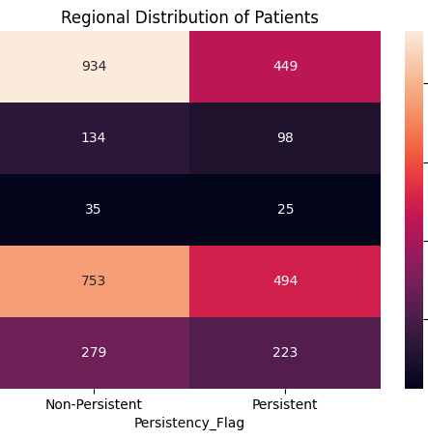
Regional Distribution of Patients
The heatmap visualizes patient distribution and drug persistency by region, offering insights into regional adherence patterns that could be vital for localized healthcare strategies.

Slide 24
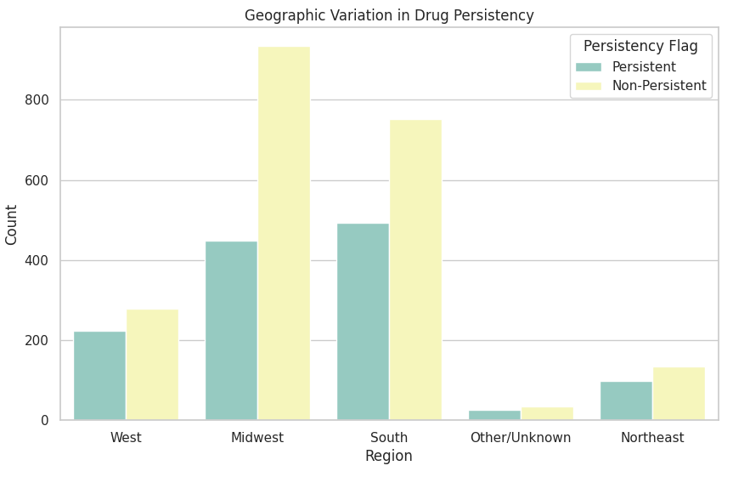
Geographic Variation in Drug Persistency
This chart presents the geographic variation in drug persistency, with certain regions showing higher rates of non-persistence, which could inform regional healthcare policy and patient outreach efforts.

Slide 25
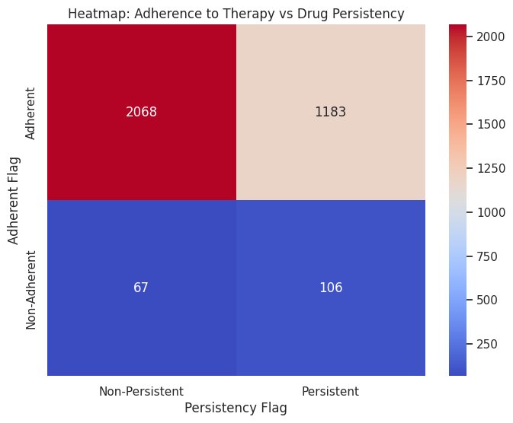
Heatmap: Adherence to Therapy vs Drug Persistency
The heatmap compares therapy adherence to drug persistency, indicating that patients who adhere to their therapy schedule are generally more persistent with their medication.

Slide 26
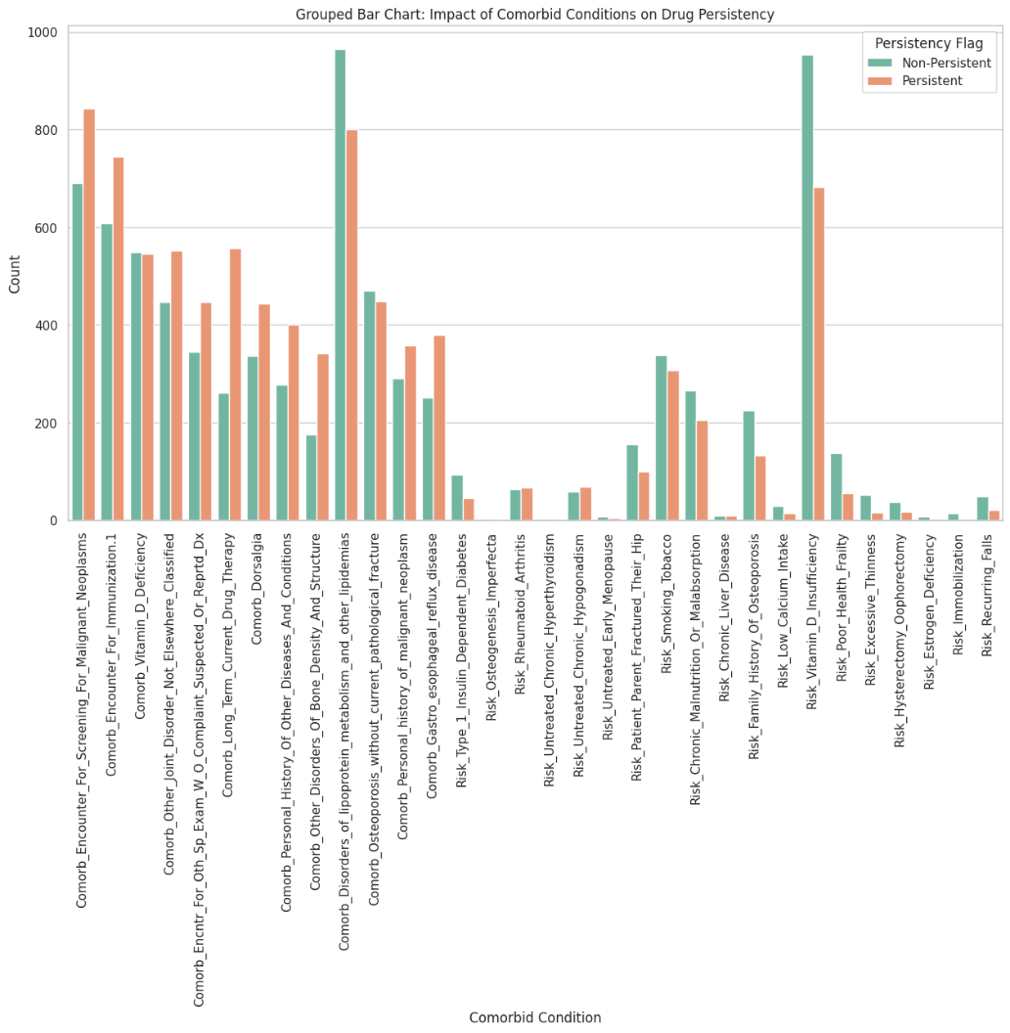
Impact of Comorbid Conditions on Drug Persistency
This chart analyzes the effects of comorbid conditions on drug persistency.
Certain conditions, such as chronic pain and hypertension, show a clear correlation with higher rates of persistency, likely due to the necessity of consistent treatment.

Slide 27
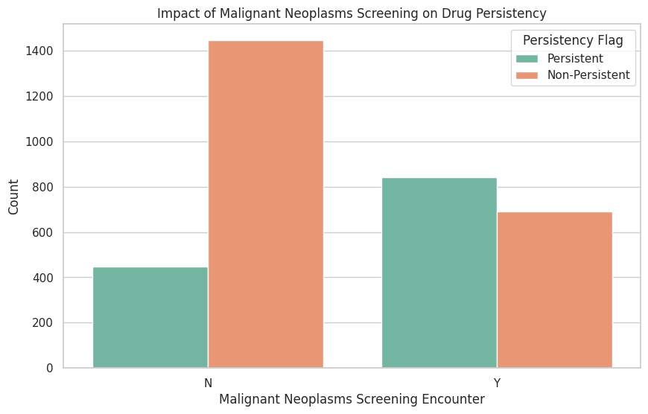
Impact of Malignant Neoplasms Screening on Drug Persistency
The bar chart demonstrates the impact of malignant neoplasms screening on drug persistency.
Patients screened for neoplasms tend to be more persistent, possibly due to increased engagement with healthcare services.

Slide 28
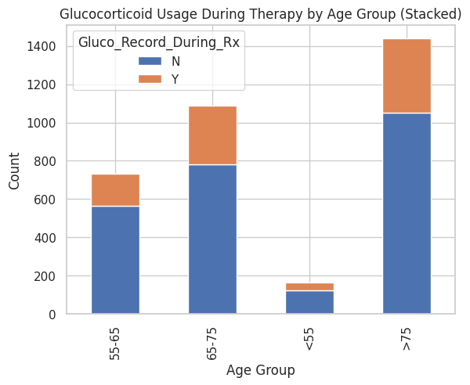
Glucocorticoid Usage During Therapy by Age Group
This stacked bar chart shows glucocorticoid usage during therapy across different age groups.
Older patients have higher usage, which may influence persistency due to the chronic nature of conditions treated with glucocorticoids.

Slide 29
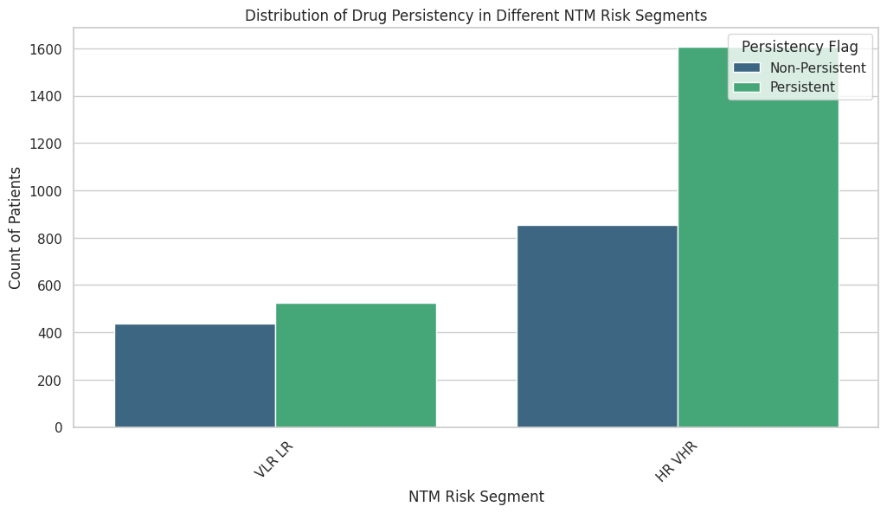
Distribution of Drug Persistency in Different NTM Risk Segments
This bar chart illustrates the distribution of drug persistency within NTM risk segments.
Patients in the higher risk segments show increased persistency, suggesting that risk awareness may motivate adherence to treatment.

Slide 30

EDA Recommendations
Personalized Patient Education: Develop individualized education programs that account for a patient's medical history, understanding level, and personal preferences to enhance medication adherence.
2. Regular Health Monitoring: Implement routine health monitoring using digital tools and in-person check-ups to track patient progress and adjust treatments as necessary.
3. Targeted Interventions: Create intervention strategies for patients with specific comorbid conditions and within demographic groups that are statistically less likely to adhere to prescribed medications.
4. Cross-Disciplinary Communication: Foster better communication between general practitioners and specialists to ensure a cohesive treatment approach, and address disparities in drug persistency across different races and regions.

Slide 31
Model Proposals for Predicting Drug Persistency
1. Support Vector Machines (SVM):
Utilizes a linear kernel to handle the binary classification of patient persistency.
Suitable for the dataset with high dimensionality, aiming to maximize the margin between classes.
2. Random Forest:
Employs 1000 trees with a maximum depth of 10, balancing the model complexity and prediction accuracy.
Incorporates ensemble learning to improve prediction robustness and manage feature diversity.
3. Decision Tree:
Simplifies the decision-making process with a max depth of 1, providing a fast and interpretable model.
Acts as a baseline to understand the primary splits affecting persistency.
4. Logistic Regression:
Applies a binary logistic regression model optimized with GridSearchCV, perfect for probability estimation.
Leverages one-hot encoding to transform categorical variables, enhancing model accuracy.
These models offer a range from simple to complex approaches, balancing interpretability and predictive power for drug persistency in healthcare data.

Slide 32
Preparing Data for Modeling:
Splitting Features and Target Variable:
The dataset (df_encoded) is divided into features (X) and the target variable (y). The target variable is 'Persistency_Flag'.
Training and Testing Sets:
The train_test_split function is used to split X and y into training and testing sets.
20% of the data is reserved for testing (test_size=0.2), ensuring a portion of data is held back for model evaluation.
random_state=42 ensures that the split is reproducible; the same rows will be split into training and testing sets each time the code is run.
Output Interpretation:
The shapes of the split datasets are displayed.
X_train and X_test each have 71 features, indicating a wide range of variables consideredf for modeling. X_train contains 2739 samples, and X_test has 685 samples, signifying the division of datainto training and testing sets.
d. ANOVA for Feature Analysis:
Conducted ANOVA to examine differences in 'Dexa_Freq_During_Rx' between 'Persistent' and 'Non-Persistent' groups.
Results: F-Value of 433.263 and P-Value of ~1.05e-90.
Indicates a significant difference in 'Dexa_Freq_During_Rx' across the two groups, suggesting its importance in predicting drug persistency.
These steps are essential in ensuring the data is correctly structured for analysis and in identifying key features that might impact the model's predictive power.

Slide 33
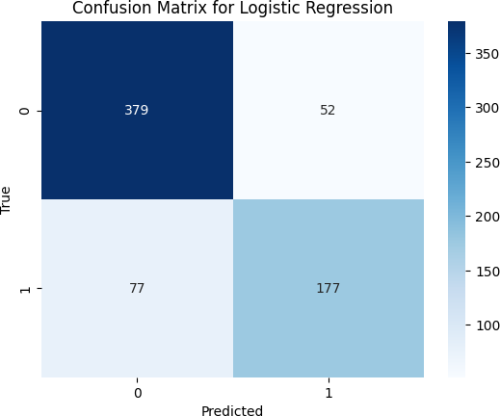
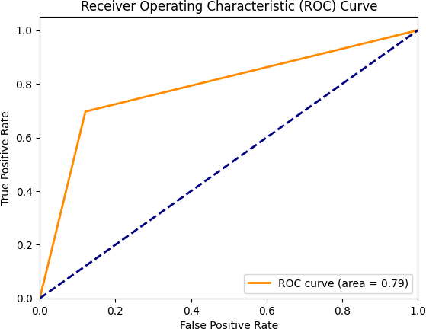
a. Linear Model: Logistic Regression
Model Introduction:
Logistic Regression used as a baseline model.
Ideal for binary classification problems like 'Persistency_Flag'.
Advantages:
Simple and interpretable model.
Provides probability scores for predictions.
Disadvantages:
May underperform with complex, non-linear relationships.
Accuracy and Precision:
Achieved 81% accuracy.
Precision: 83% for Non-Persistent, 77% for Persistent cases.
Recall and F1-Score:
Recall: 88% for Non-Persistent, 70% for Persistent.
F1-scores: 85% for Non-Persistent, 73% for Persistent.
Confusion Matrix:
Shows a higher accuracy in predicting Non-Persistent cases.
Indicates a tendency to under-predict persistency.
ROC Curve:
ROC-AUC score at 0.788, suggesting moderate discrimination ability.
Suggests room for improvement in model sensitivity and specificity.
Key Takeaways:
The model is more effective in identifying Non-Persistent cases.
Good balance in precision and recall for Non-Persistent cases but can improve for Persistent cases.
Model shows potential, but exploring additional features or more complex models could
enhance performance.
15

Slide 34
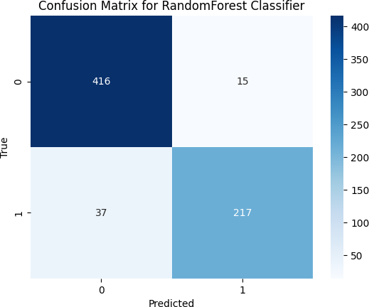
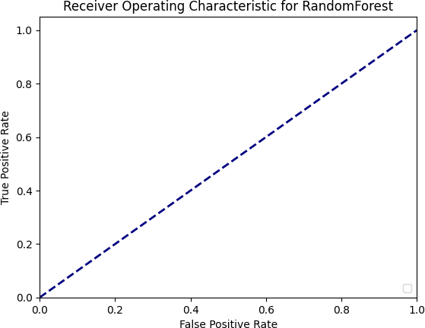
b. Ensemble Model: Random Forest
Model Introduction:
Random Forest, an ensemble learning method, used for its robustness.
Handles large data sets with higher dimensionality well.
Advantages:
Effective for complex datasets.
Reduces overfitting risk due to ensemble approach.
Disadvantages:
More computationally intensive.
Less interpretable than simpler models.
Accuracy and Precision:
Achieved a high accuracy of 92%.
Precision: 92% for Non-Persistent, 94% for Persistent cases.
Recall and F1-Score:
Recall: 97% for Non-Persistent, 85% for Persistent.
F1-scores: 94% for Non-Persistent, 89% for Persistent.
Confusion Matrix:
Shows excellent performance in identifying Non-Persistent cases.
Indicates better balance in predicting both Non-Persistent and Persistent cases compared to Logistic Regression.
ROC Curve:
The ROC curve for the Random Forest model, positioned near the top left corner with a high AUC, indicates excellent predictive accuracy in distinguishing between. Non-Persistent and Persistent cases
Key Takeaways:
The Random Forest model shows a notable improvement over Logistic Regression in both accuracy and balance between the classes.
High precision and recall, especially for Non-Persistent cases, indicating strong predictive capabilities.

Slide 35
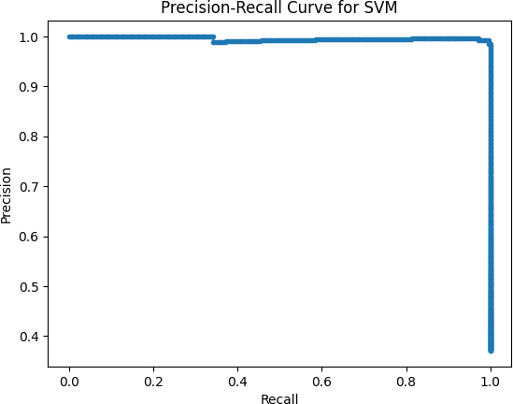
c. Support Vector Machine (SVM):
Model Introduction:
SVM is used for its effectiveness in high-dimensional spaces.
Particularly suitable for binary classification problems like 'Persistency_Flag'.
Advantages:
High accuracy in classification tasks.
Effective in cases where the number of dimensions exceeds the number of samples.
Disadvantages:
Can be less effective on very large datasets.
Requires careful selection of kernel and regularization parameters.
Accuracy and Precision:
Exceptional accuracy of 99%, indicating excellent model performance.
Precision: 100% for Non-Persistent, 98% for Persistent cases.
Recall and F1-Score:
Recall: 99% for Non-Persistent, 100% for Persistent.
F1-scores: 99% for both Non-Persistent and Persistent cases.
Precision-Recall Curve:
The Precision-Recall curve indicates outstanding performance, as it hovers close to the top right corner, showing both high precision and high recall.
This suggests that the SVM model effectively balances correctly identifying positive (Persistent) cases (high recall) while maintaining a low rate of false positives (high precision).
Key Takeaways:
The SVM model shows outstanding performance, outshining both Logistic Regression and Random Forest in accuracy and class balance.
High precision and recall across both categories highlight its robustness in handling this classification task.

Slide 36
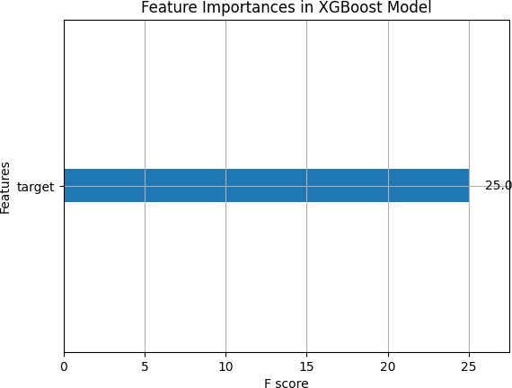
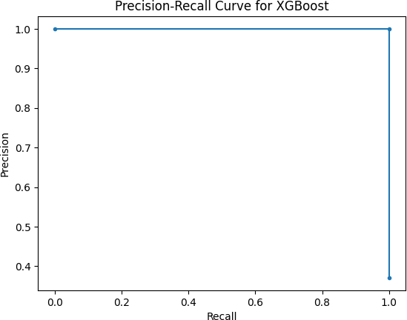
d. Gradient Boosting:
Model Introduction:
Gradient Boosting, an advanced ensemble technique, known for high accuracy.
Sequentially builds weak learners to improve predictions.
Advantages:
Often provides high predictive accuracy.
Good control over overfitting through hyperparameters.
Disadvantages:
Time-consuming training process.
Requires careful tuning to avoid overfitting.
Accuracy and Precision:
Achieved a perfect accuracy of 100%, showcasing exceptional model performance.
Precision: 100% for both Non-Persistent and Persistent cases.
Recall and F1-Score:
Recall: 100% for both Non-Persistent and Persistent cases.
F1-scores: 100% for both categories, indicating flawless balance between precision and recall.
Feature Importance:
Reveals the most significant features that the model relied on for making predictions.
Provides insights into which aspects of the data are most influential in determining patient drug persistency.
Precision-Recall Curve for XGBoost:
The Precision-Recall Curve shows that the XGBoost model achieves nearly perfect precision across all levels of recall.
This indicates that the model is able to identify the persistent class with high accuracy, maintaining a high true positive rate without increasing the false positives.
Key Takeaways:
The XGBoost model demonstrates unparalleled performance in this classification task, with unmatched precision, recall, and accuracy.
Its ability to perfectly classify cases is impressive, though it's crucial to consider the potential for overfitting, especially in a real-world scenario where data may not always be as clean or well-defined.
19

Slide 37
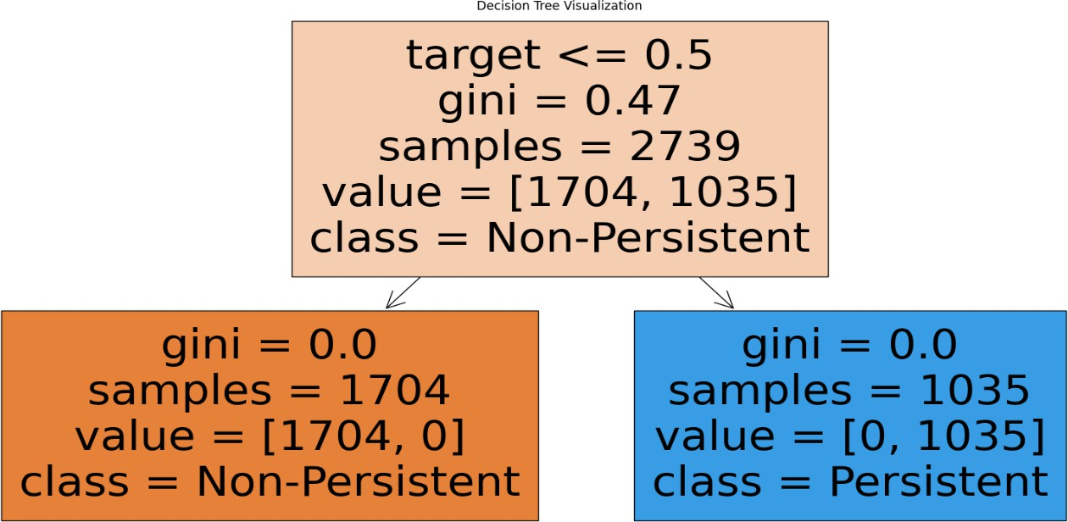
e. Decision Tree
Model Introduction:
Decision Tree Classifier, a simple yet powerful model for classification tasks.
Offers a clear visualization of the decision-making process.
Advantages:
Easy to understand and interpret.
Can handle both numerical and categorical data.
Disadvantages:
Prone to overfitting, especially with complex trees.
Can be unstable, as small variations in data might lead to a completely different tree.
Accuracy and Precision:
Perfect accuracy of 100%, indicating exceptional performance.
Precision: 100% for both Non-Persistent and Persistent cases.
Recall and F1-Score:
Recall: 100% for both Non-Persistent and Persistent cases.
F1-scores: 100% for both categories, showing ideal balance between precision and recall.
The initial split on the 'target' feature with a threshold of ≤ 0.5 results in perfect classification with no misclassification in the first split.
Subsequent splits further refine the model's decision boundaries, effectively capturing more complex patterns in the data.
Key Takeaways:
The Decision Tree model exhibits outstanding performance, achieving flawless classification.
The model’s simplicity, coupled with its perfect scoring across all metrics, underscores its
efficiency for this dataset.
While the results are impressive, it's important to be cautious about overfitting, as decision trees can perfectly fit the training data, especially in cases of clean, well-structured datasets.

Slide 38

Thank You

